Slide 1
Azure security and management
for your hybrid environment
Kris Swanson
Partner Technology Strategist
Microsoft Corporation

Slide 2
Table of contents
1
Challenges
2
Azure Security Center
3
Cloud Management and Monitoring
4
Solution architecture

Slide 3
Challenges

Slide 4



Digital transformation is driving change
IT embracing change
Business units
Developers
Rise of cloud workload owners | Security is everyone’s issue | Need to expand beyond management contacts

Slide 5
Cloud adoption is growing
Cloud
90%
of Fortune 500 use Microsoft Cloud
Identity
Compute
Storage
Networking
1: Rightscale: 2017 State of Cloud Survey http://www.rightscale.com/blog/cloud-industry-insights/cloud-computing-trends-2017-state-cloud-survey#hybrid-cloud

Slide 6
While cloud is growing, hybrid is the most common approach
On-premises and
Cloud
>67%
Enterprises adopting hybrid cloud in 2017¹
Identity
Compute
Storage
Networking
1: Rightscale: 2017 State of Cloud Survey http://www.rightscale.com/blog/cloud-industry-insights/cloud-computing-trends-2017-state-cloud-survey#hybrid-cloud

Slide 7
Securing Azure resources is a shared responsibility between Microsoft and the customer
MICROSOFT’S COMMITMENT
JOINT RESPONSIBILITY
Securing and managing the cloud foundation
Securing and managing your cloud resources
Physical assets
Virtual machines
Datacenter operations
Applications & workloads
Cloud infrastructure
Data

Slide 8
Shared Responsibility within App Models
Highest integrated security Lowest operational costs
Higher operational control Higher security costs
Server- less
Web Apps
Logic Apps
API Apps
Container Apps
Custom Scale-Out Apps
Custom IaaS Apps
AZURE APP SERVICE
SERVICE FABRIC AND CONTAINER SERVICE
VM SCALE SETS
AZURE VIRTUAL MACHINES

Slide 9
Hybrid cloud security challenges
DISTRIBUTED INFRASTRUCTURE
Management complexity
Rapidly evolving threats
Notes:
this is part of the Fear, Uncertainty, and Doubt (FUD) message – Hybrid cloud makes the deployment, management, and securing of a customer infrastructure more complex. At the same time, the attacks are come more often from more directions. I often use the “Security Breach Infographic”: https://informationisbeautiful.net/visualizations/worlds-biggest-data-breaches-hacks/

Slide 10




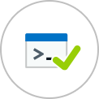


Security analytics are key
COLLECTIVE WISDOM Cloud effect Data, data, data
Notes:
this is introducing the use of big data to address one aspect of zero day attacks

Slide 11
The Azure difference

Slide 12


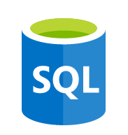





App
frontend
Real-time correlation
and analytics
Middleware
Application
insights
Backend
Built-in operational
visibility
Operating
system
Data ingestion and correlation
Linux
Microsoft Azure
Log
analytics
Virtual
machine
Flexible turn-key integrations
Networking
Monitor
Virtual network
Load balancer
DNS
Actionable app-aware insights

Slide 13
Microsoft Azure Security Center

Slide 14
Microsoft Azure Security Center
Unify security management and enable advanced threat protection for hybrid cloud workloads
Unified visibility and control
Adaptive threat prevention
Intelligent detection and response

Slide 15

Security & Compliance customers can now use Azure Security Center
Support Azure, on-premises, and other clouds
Security data collection, search, and analysis
Notable events
Advanced threat detection
Comprehensive security dashboards
Interactive threat intelligence map
AZURE SECURITY CENTER
Same Infrastructure
Azure Security Center now leverages the Log Analytics agent and workspaces – providing a scalable log collection and analytics platform
Zero Effort
Automatically discovers existing workspaces with Security & Compliance and any connected computers - no work is required to start using Azure Security Center
BUILT ON CLOUD LOG ANALYTICS PLATFORM

Slide 16
Unified visibility and control
Dynamically discover and manage the security of your hybrid cloud workloads in a single cloud-based console

Slide 17
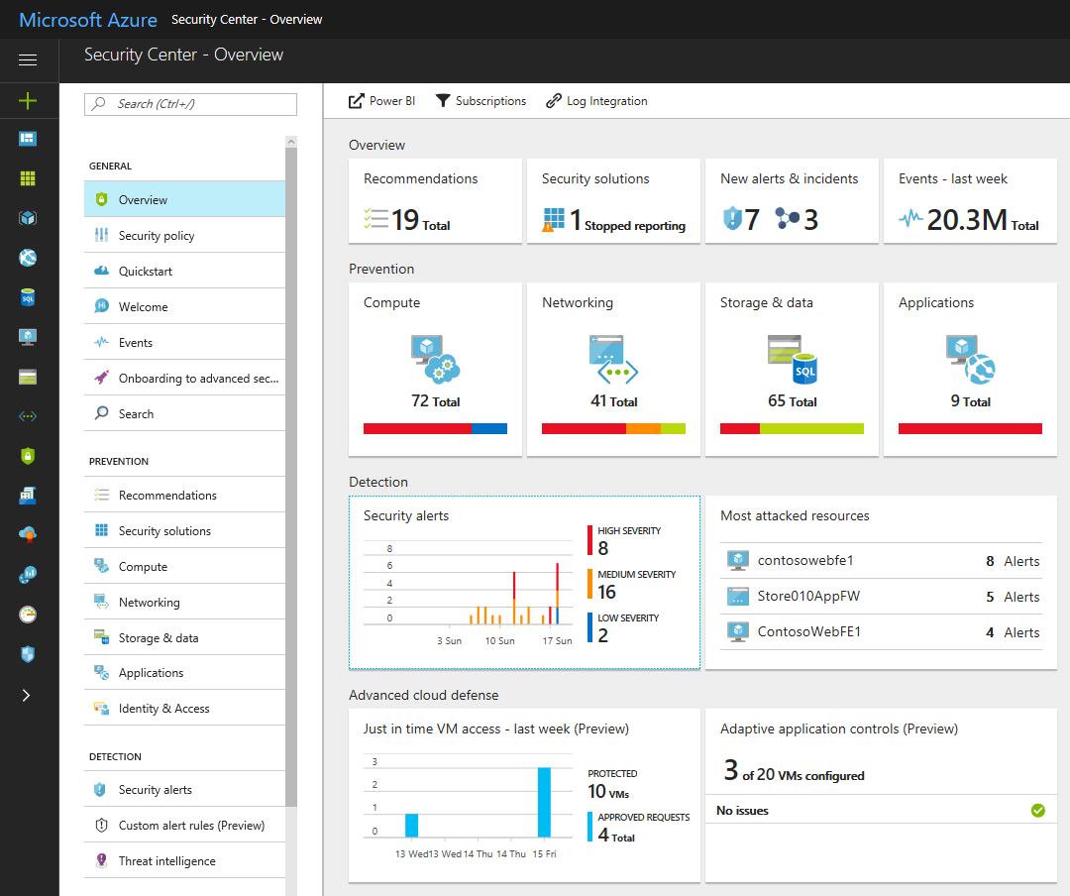
Manage security across all your hybrid cloud workloads in one console
NOW HYBRID

Slide 18
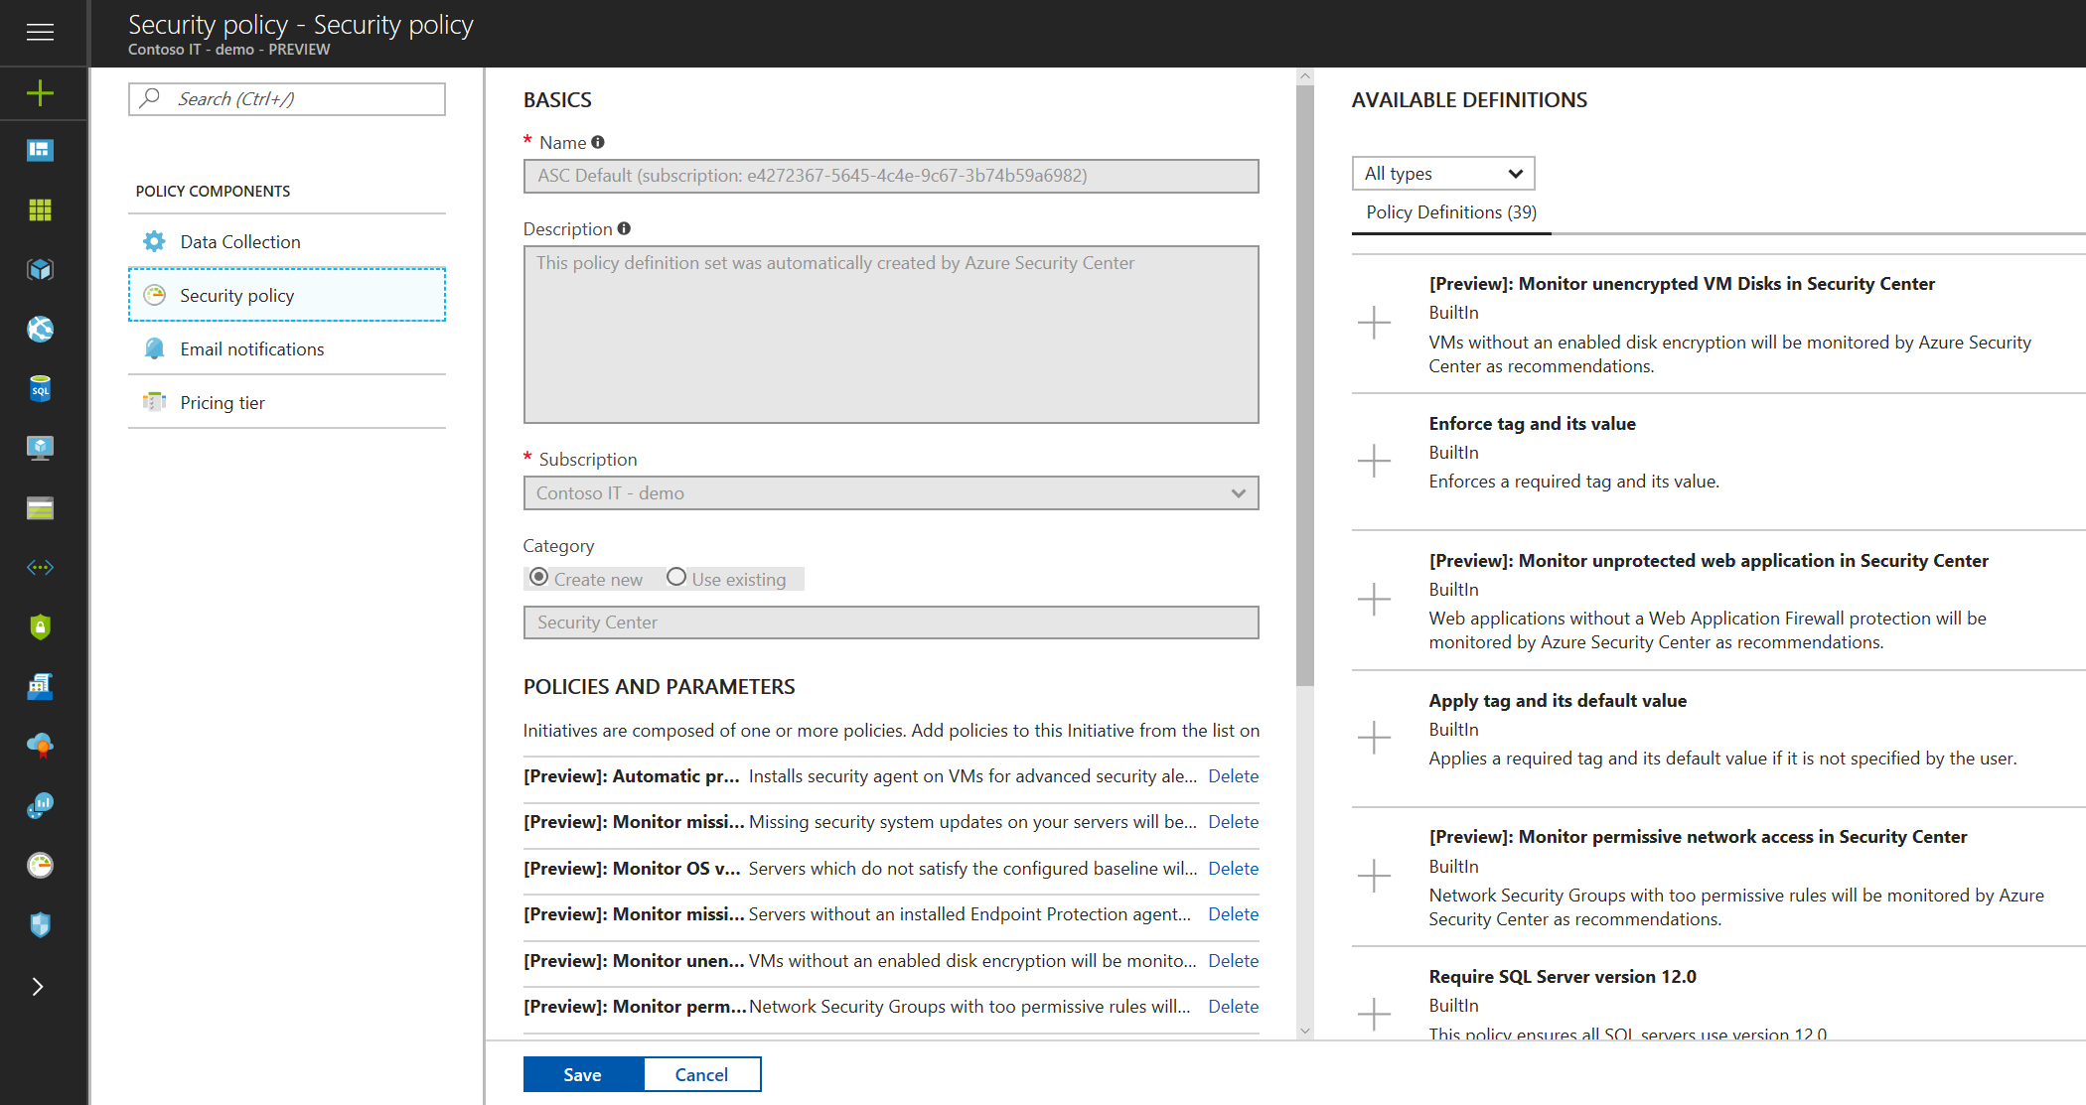
Ensure compliance with company or regulatory security requirements
CENTRAL POLICY MANAGEMENT
Define a security policy for each subscription in Security Center
Apply across multiple subscriptions using Azure Management Groups
discovery and onboarding
Automatically discover new Azure resources, apply policy, and provision the monitoring agent

Slide 19
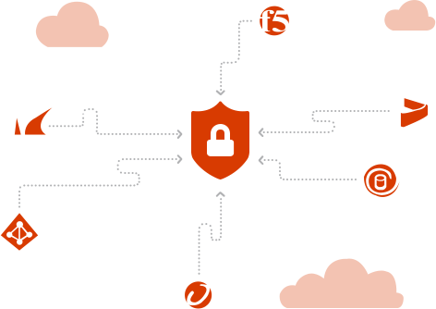
Collect, search, and analyze security data from a variety of sources
INTEGRATED PARTNERS
Connected security solutions running in Azure, e.g. firewalls and antimalware solutions
MICROSOFT SECURITY
Azure Active Directory Information Protection
Advanced Threat Analytics
MANY OTHERS
Any security solution that support Common Event Format (CEF)

Slide 20
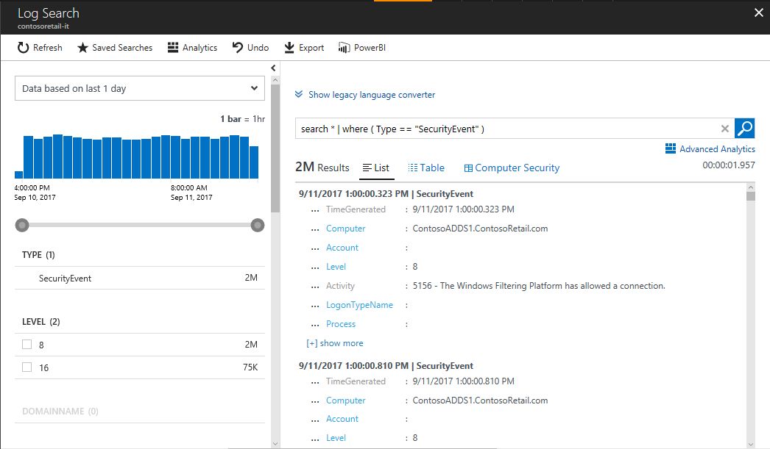
Search and analyze security data using a flexible query language

Slide 21
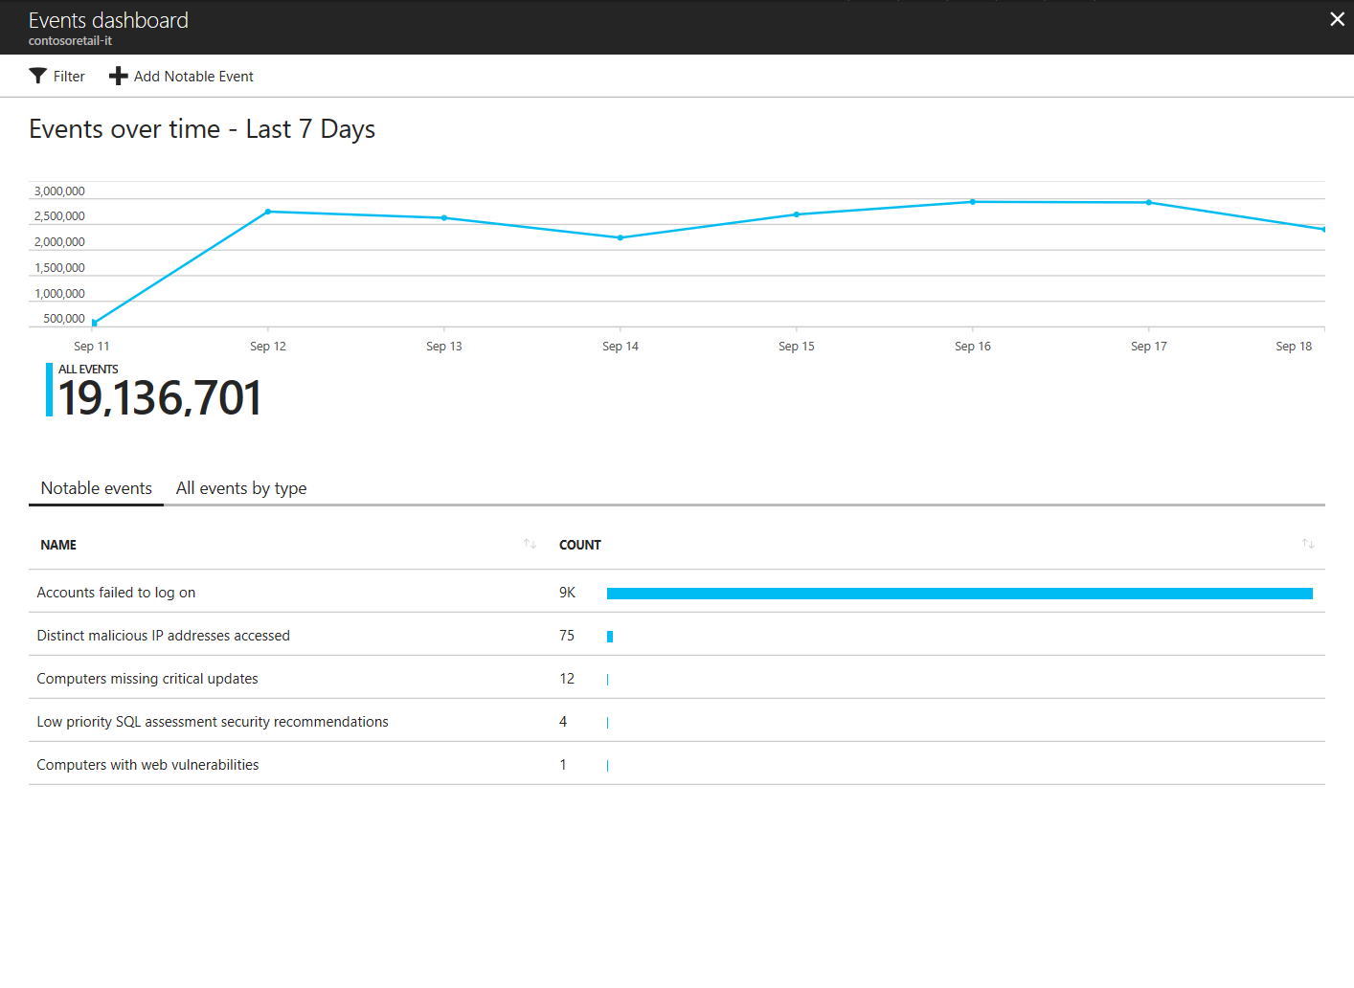
Use built-in notable events to monitor specific event types or create your own watchlist

Slide 22
Adaptive threat prevention
Enable actionable, adaptive protections that identify and mitigate risk to reduce exposure to attacks

Slide 23

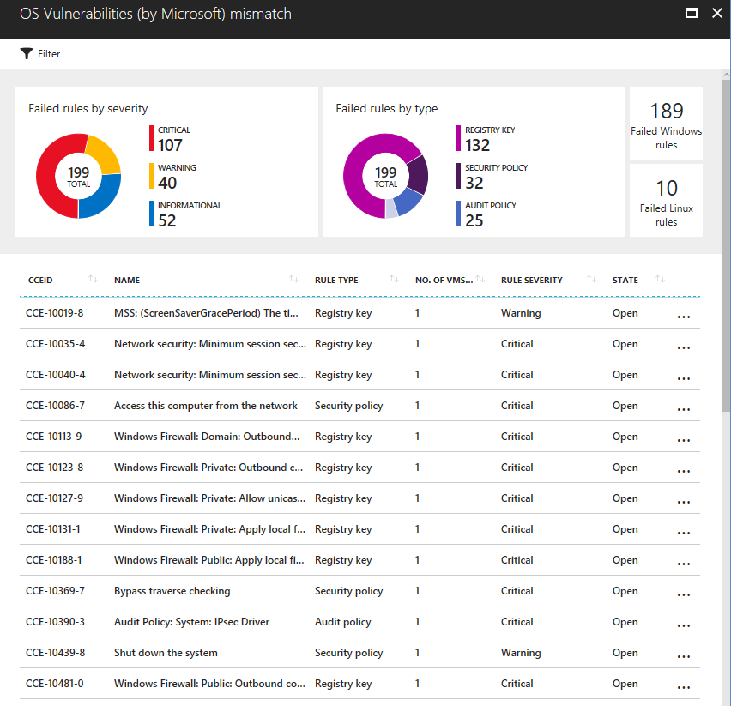
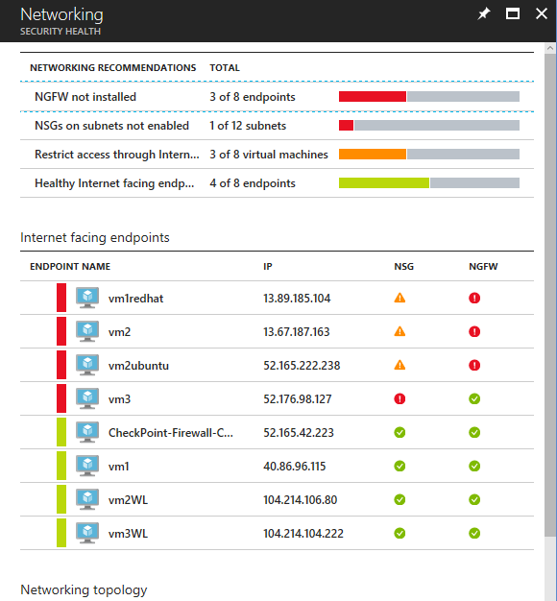

Identify vulnerabilities with continuous security assessment
VMs and computers
System update status
Antimalware protection
OS and web server config
Disk Encryption
Azure services
Network Security Groups
Firewalls
Storage and SQL Encryption
SQ Auditing and Threat Detection
Web Apps

Slide 24
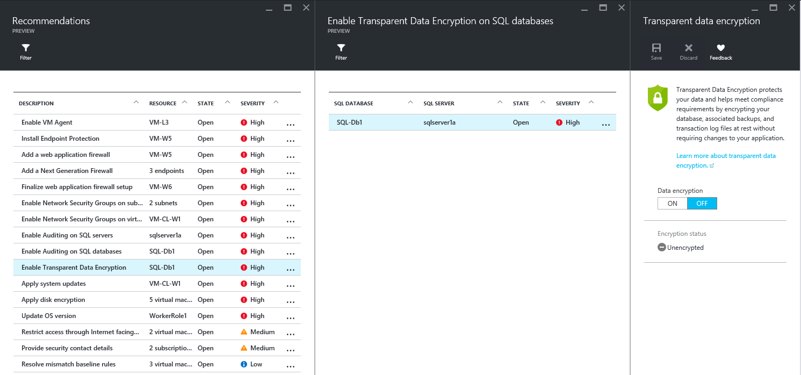
Remediate security vulnerabilities with prioritized, actionable security recommendations

Slide 25
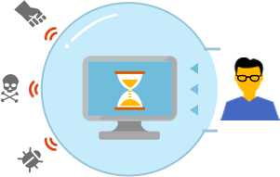
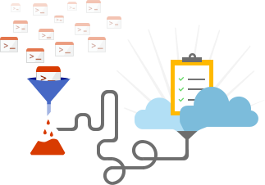
Built in cyber defenses help block malicious access and applications
Just-in-time access
Prescriptive application whitelisting

Slide 26
What’s the most common attack against Azure?

Slide 27
Brute force attacks commonly target VMs
RDP
SSH
100,000 attacks/month
On average Azure VMs are the subject to 100,000 brute force attacks targeting management ports, most commonly RDP and SSH ports
Easy access
Access to VMs requires only local admin credentials, which are easier targets for brute attacks than more carefully managed domain accounts
Always open
While access to management ports is only required sporadically, these ports are often left open for convenience or by accident

Slide 28
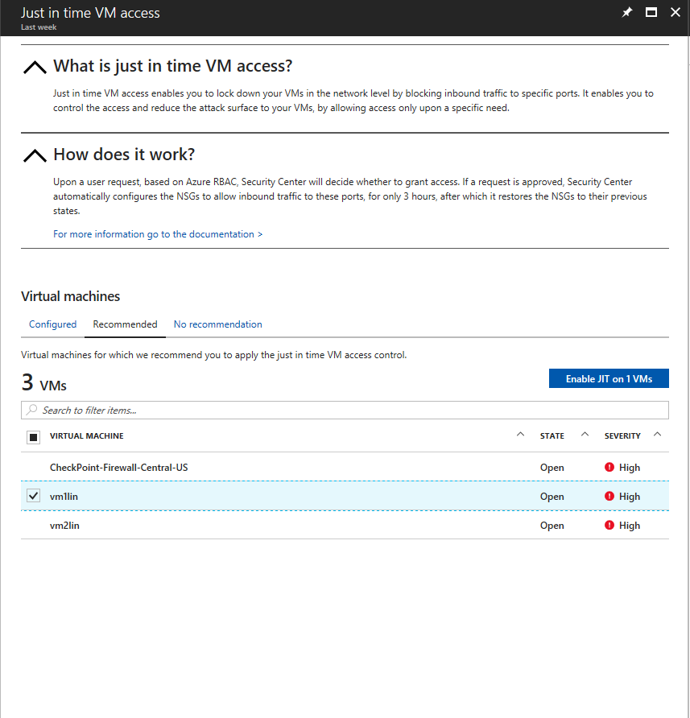
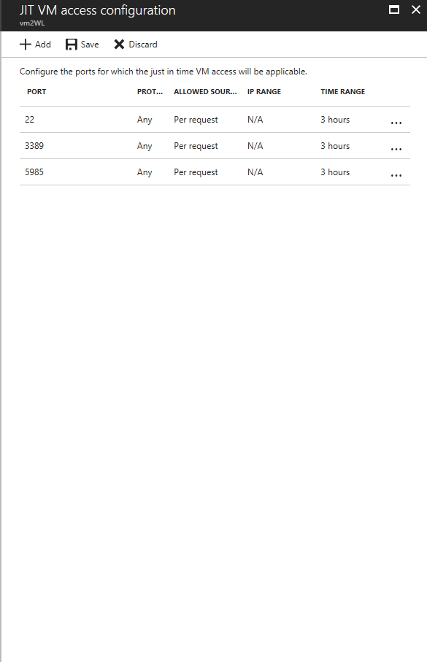
Limit exposure to brute force attacks with just-in-time access to virtual machines
INTRODUCING
Preview

Slide 29


Malware is rampant and rapidly evolving
Always evolving
Malware is constantly changing - you can no longer rely on antimalware software to detect and remove malicious code from running on your machines
Hard to block
Application controls can be very effective at blocking malware and unwanted applications, but management of whitelists can be labor-intensive and error prone
BUILT ON CLOUD LOG ANALYTICS PLATFORM

Slide 30
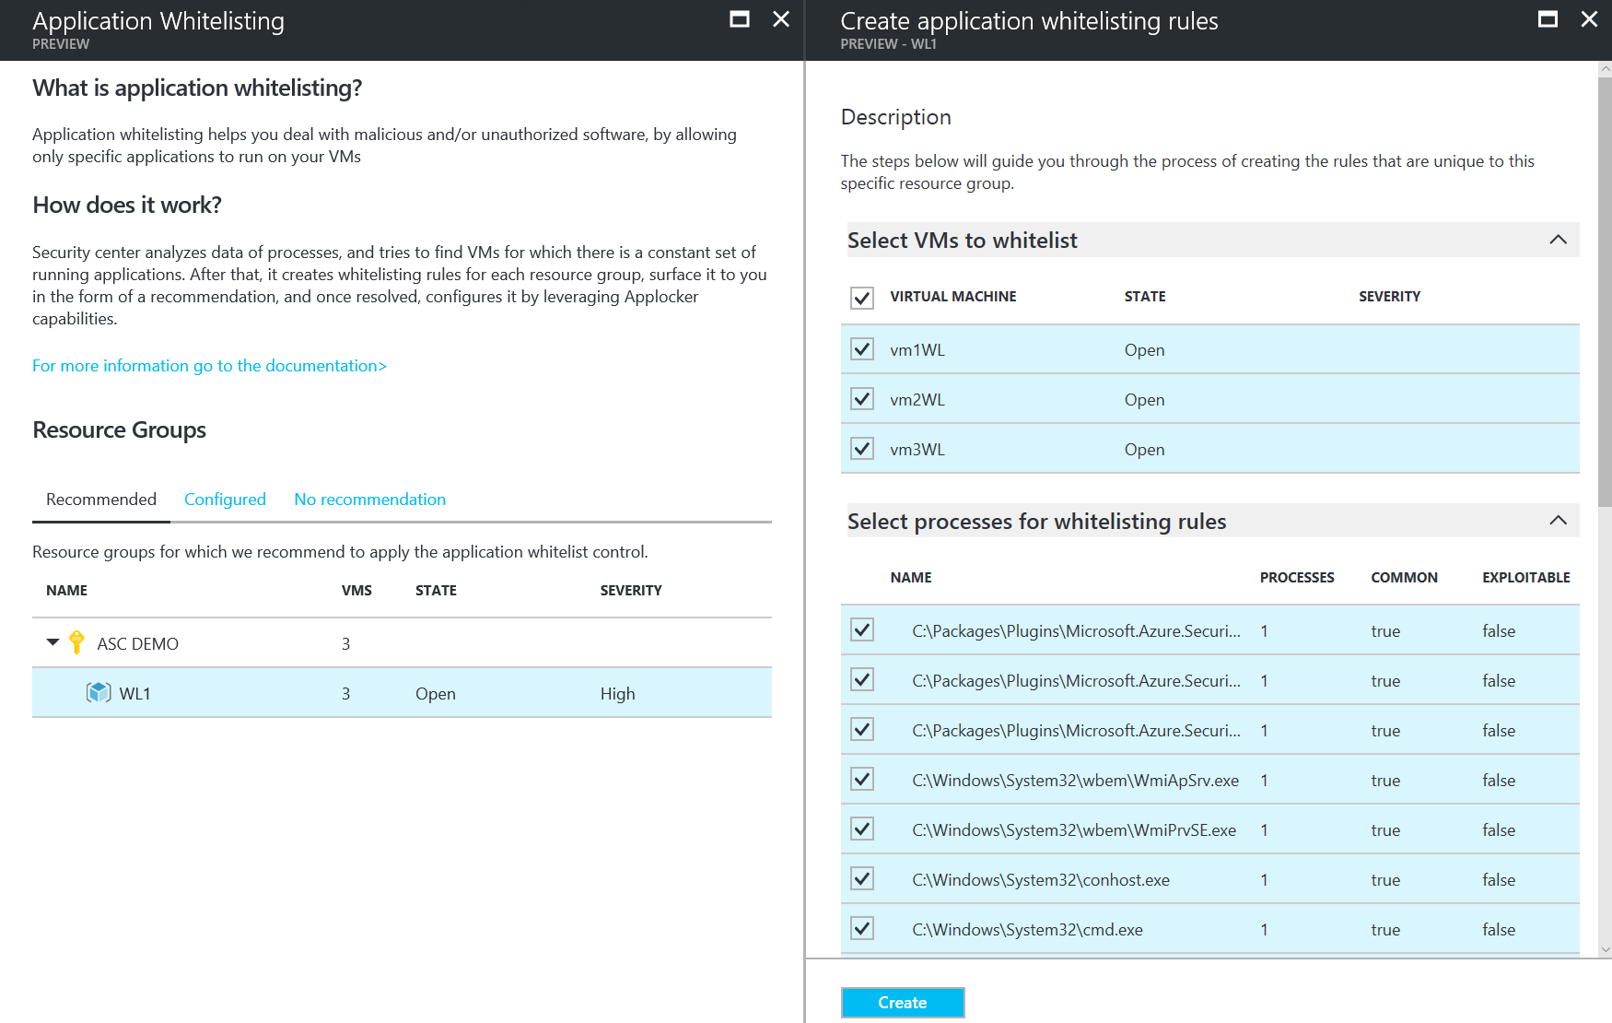
Prescriptive application whitelisting learns application patterns and recommends whitelists
INTRODUCING
Preview

Slide 31
Intelligent Detection and Response
Use advanced analytics and Microsoft Intelligent Security Graph to rapidly detect and respond to evolving cyber threats

Slide 32
Detect threats across the kill chain
Target and attack
Inbound brute force RDP, SSH, SQL attacks and more
Application and DDoS attacks (WAF partners)
Intrusion detection (NG Firewall partners)
Install and exploit
In-memory malware and exploit attempts
Suspicious process execution
Lateral movement
Internal reconnaissance
Post breach
Communication to a known malicious IP (data exfiltration or command and control)
Using compromised resources to mount additional attacks (outbound port scanning, brute force RDP/SSH attacks, DDoS, and spam)
Windows Defender ATP

Slide 33
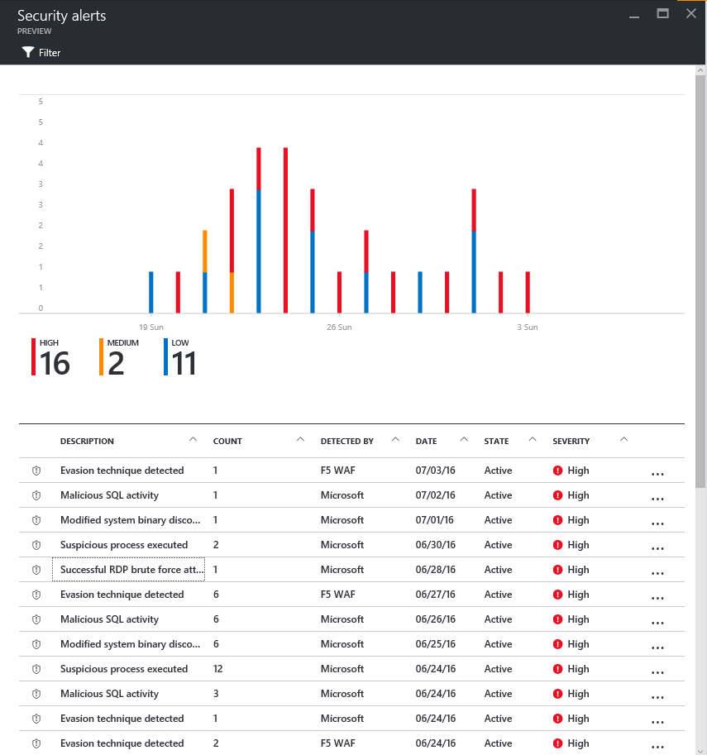
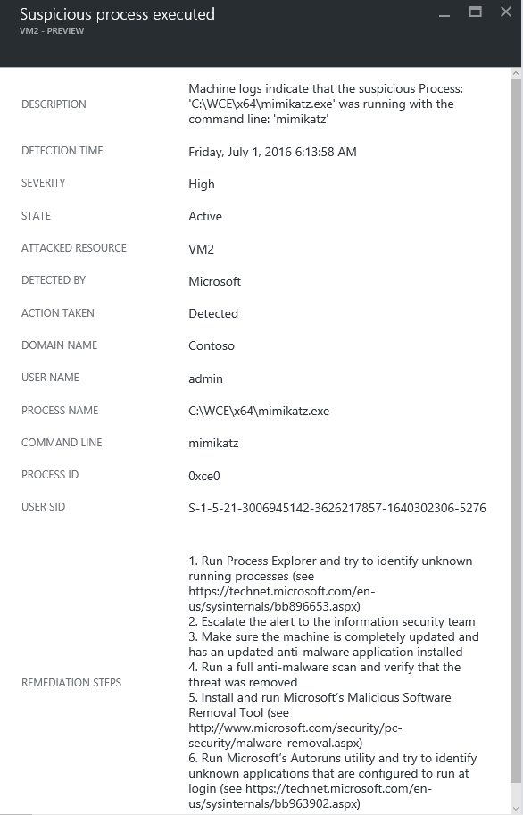
Prioritized security alerts provide details about the threat detected and suggests steps to remediate

Slide 34
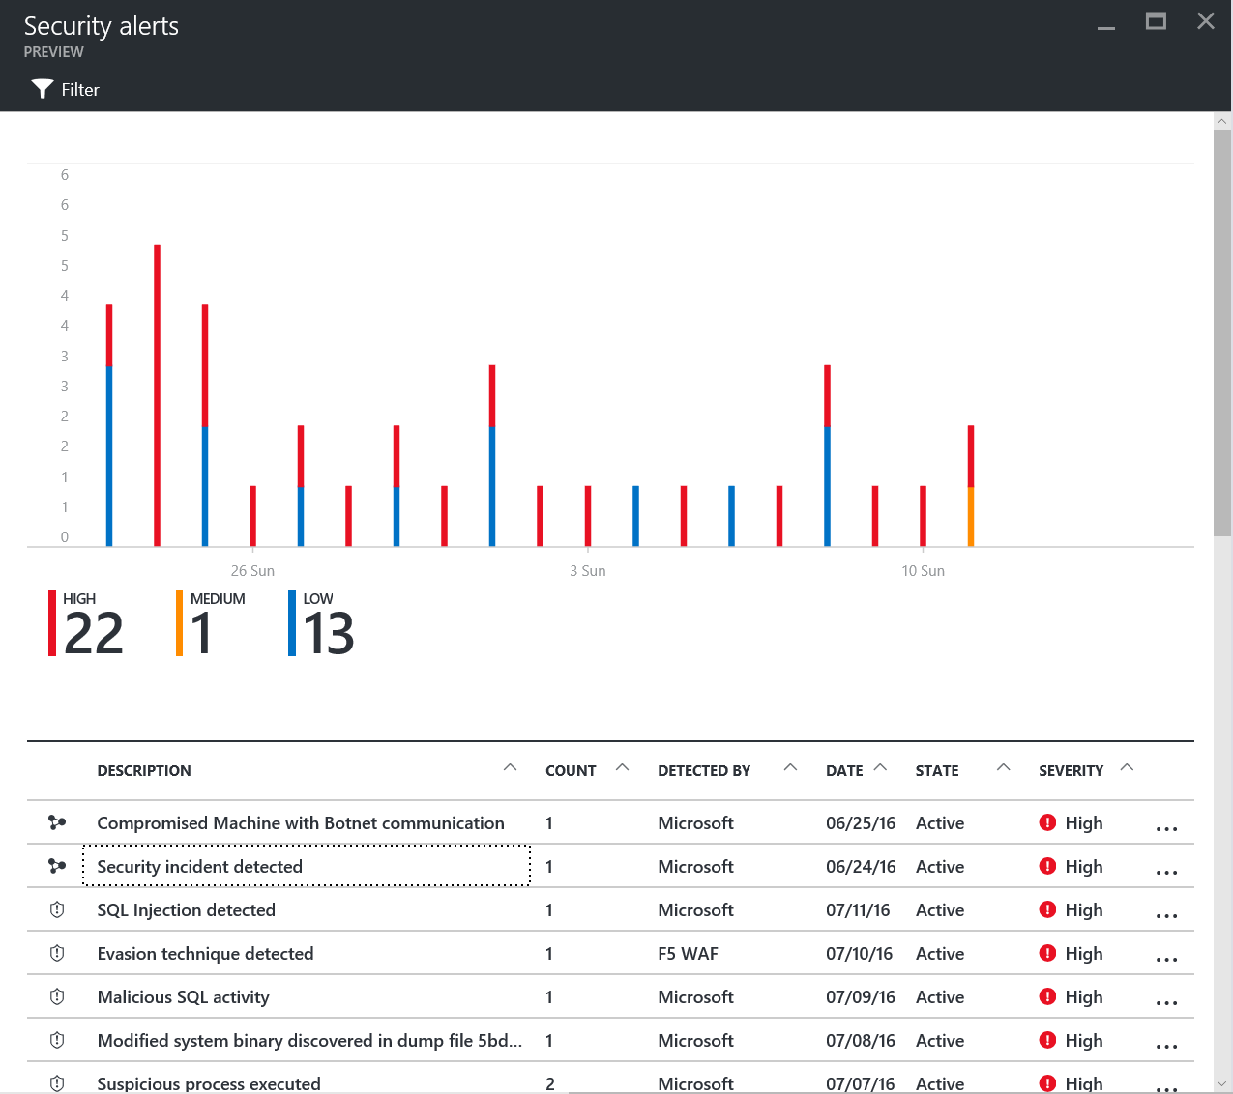
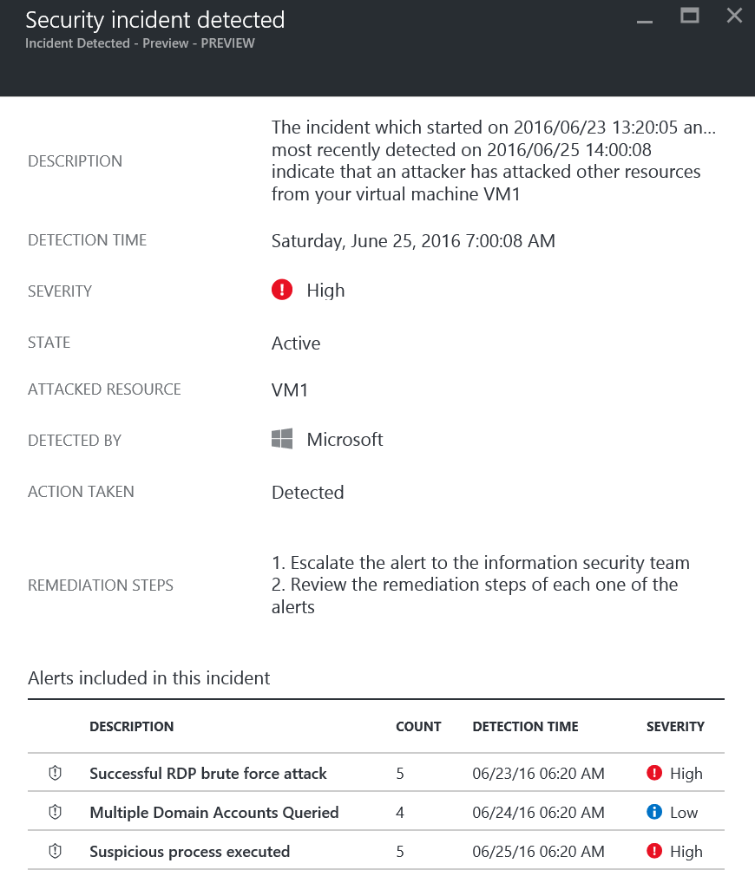
Alerts that conform to kill chain patterns are fused into a single incident

Slide 35

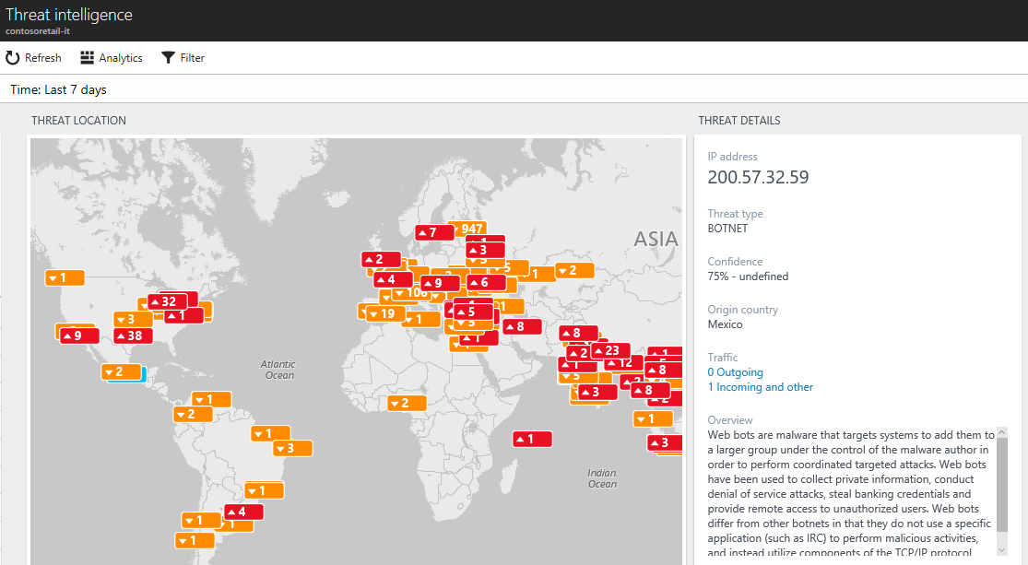

Gain valuable insights about your attackers with threat intelligence from Microsoft
Interactive map
Visualize traffic to/from malicious IPs
Analyzes data from your computers and firewalls logs
Threat reports
Attacker’s known objectives, tactics, and techniques

Slide 36
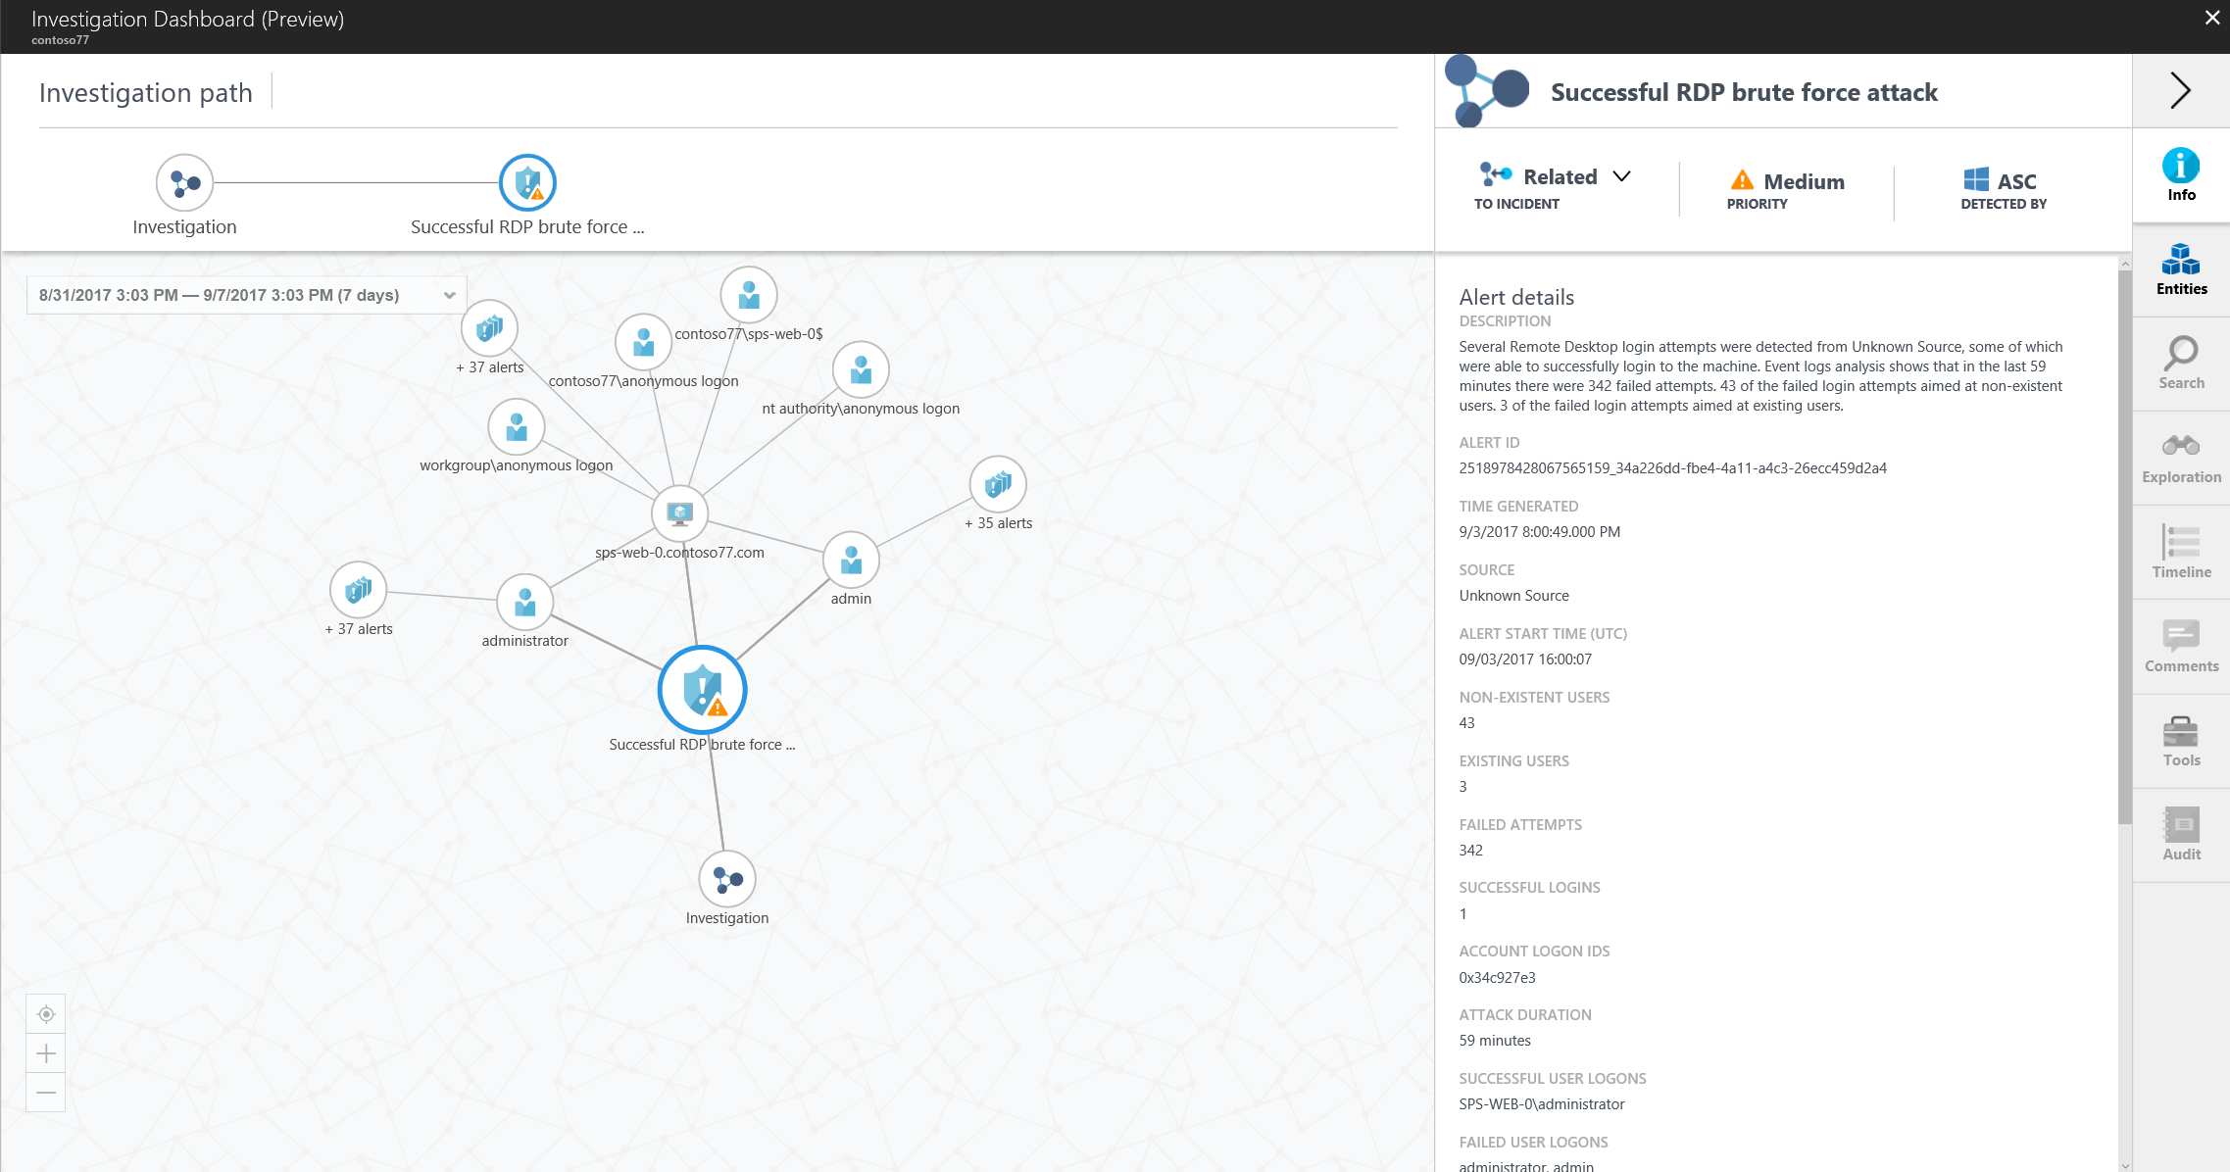
Explore notable links between alerts, computers, and users to triage alerts, determine the scope, and find the root cause

Slide 37
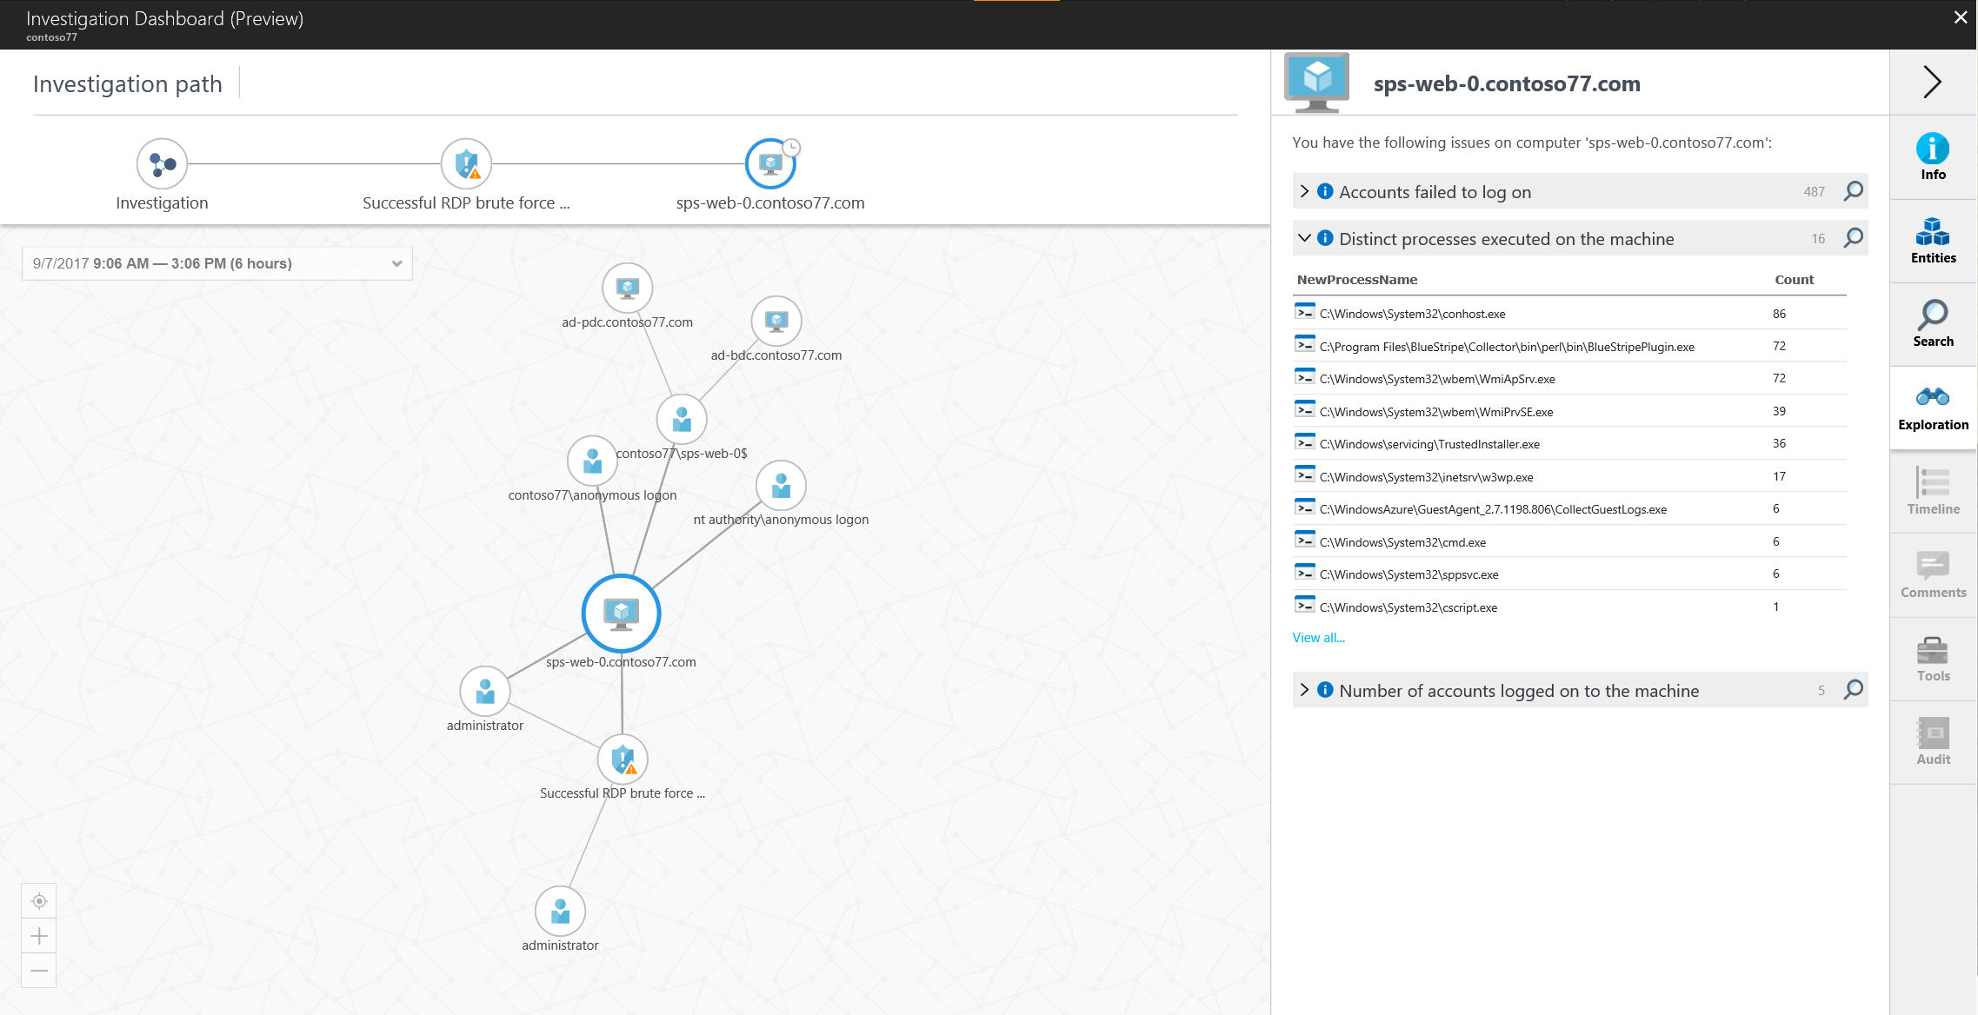
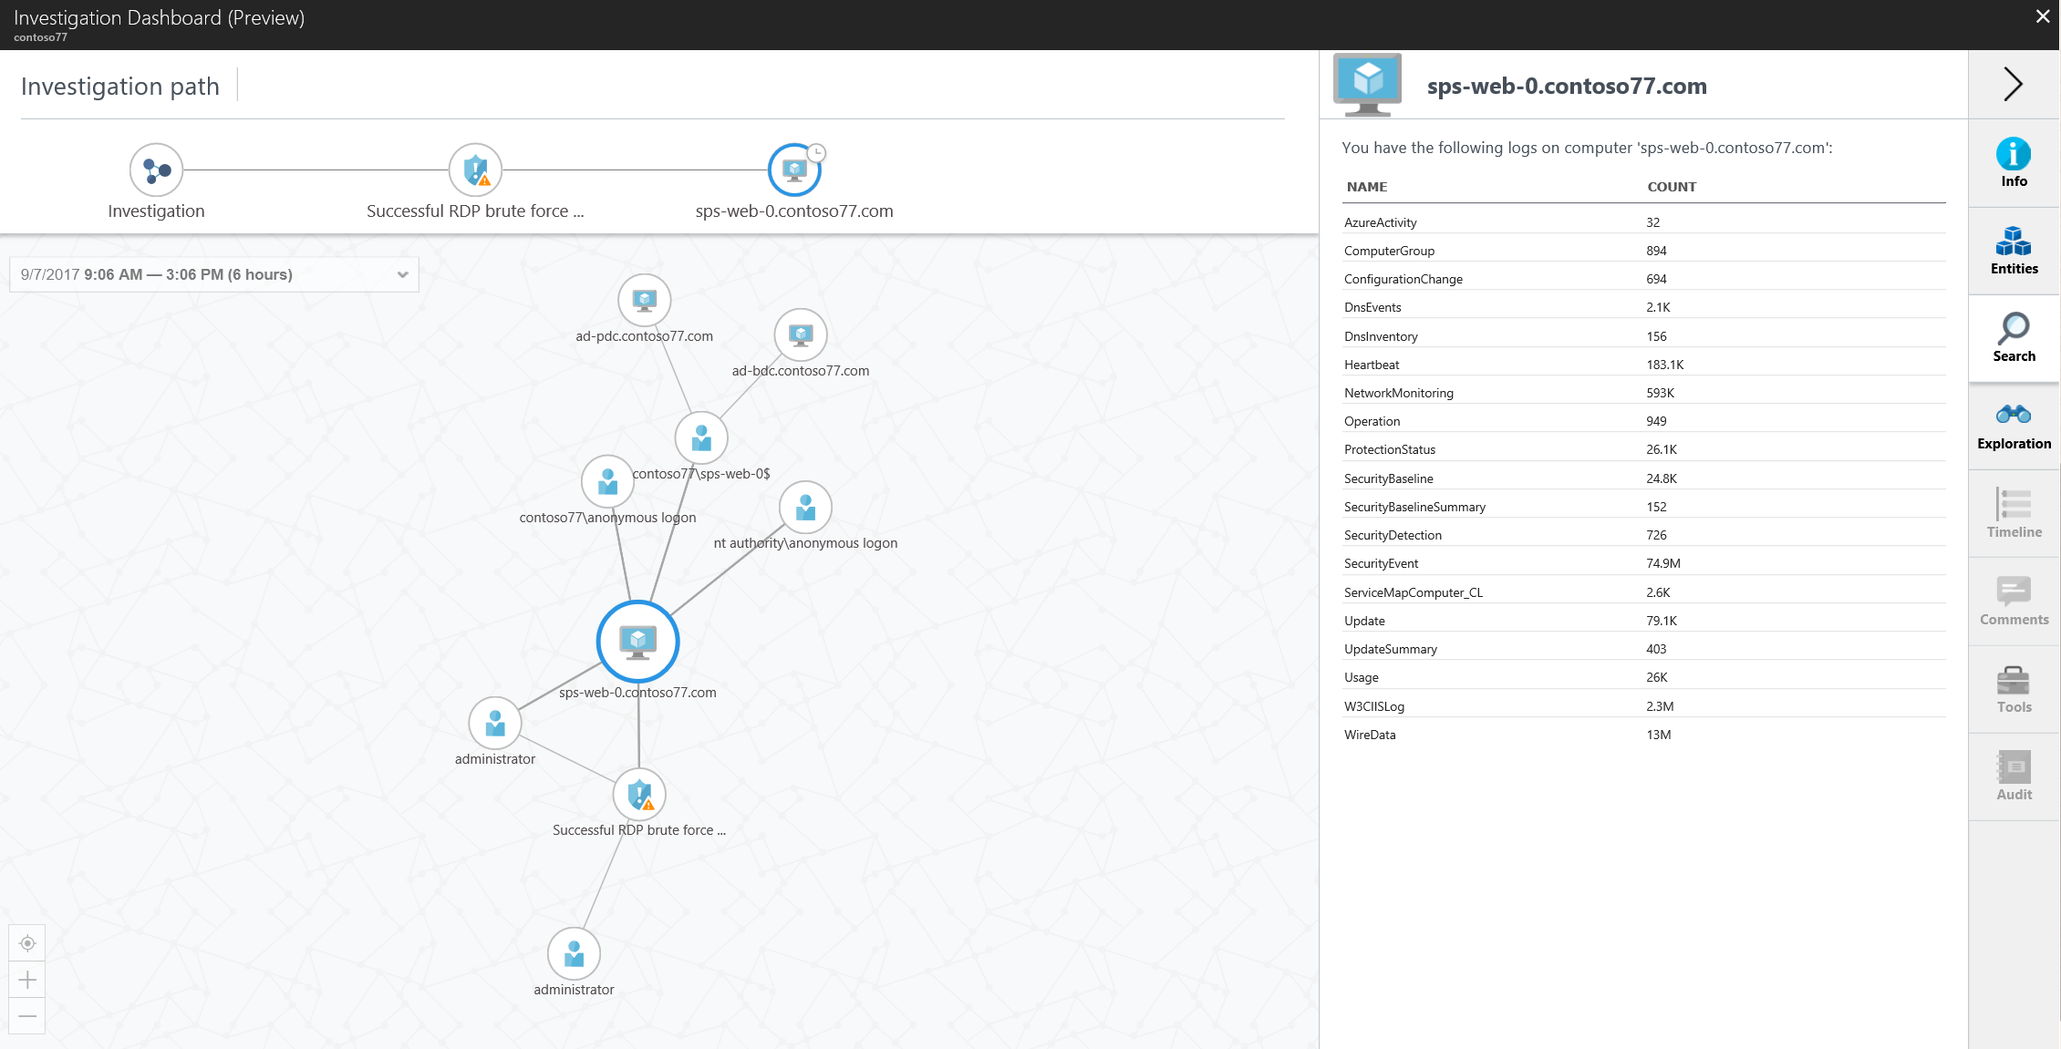
Use predefined or ad hoc queries for deeper examination of security and operational events

Slide 38
Automate security workflows with Logic Apps integration
CREATE WORKLOWS
Design workflows using the Security Center connector and templates
Include conditional actions based on alert details
RUN & MANAGE
Create and edit workflows from Azure Security Center
Trigger a workflow from any alert
View status and run history
COMMON WORKFLOWS
Route alerts to a ticketing system
Gather additional information
Apply additional security controls
Ask a user to validate an action
Block a suspicious user account
Restrict traffic from an IP address

Slide 39
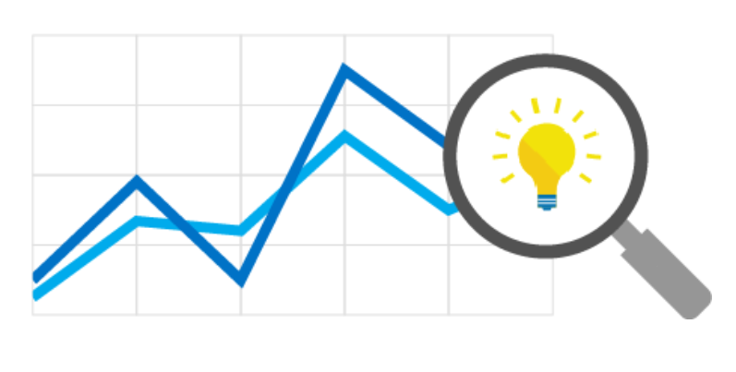
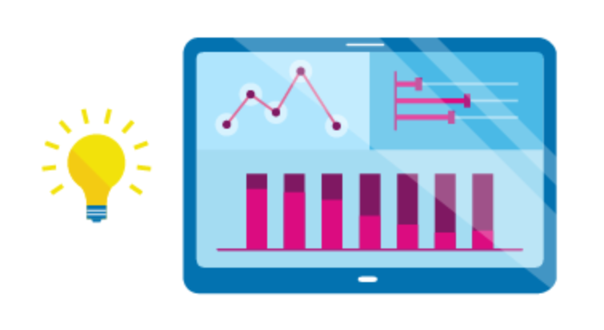
Cloud Management and Monitoring

Slide 40
Cloud Management and Monitoring
Azure offers 4 native tools for managing and monitoring your cloud and on-premises environments
Insight and Analytics
Azure Automation and Control
Security and Compliance
Protection and Recovery

Slide 41

Insights and Analytics

Slide 42
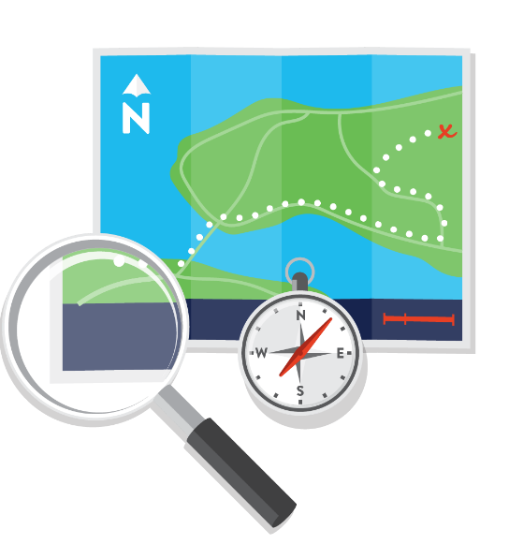
Insight to drive action
Using insights to drive action
Connect & Collect
Discover & Correlate
Map & Visualize
Diagnose & Fix
Data
Insights
Action
Visibility across platforms, applications, and workloads
Bridging developments and IT Operations workflow

Slide 43
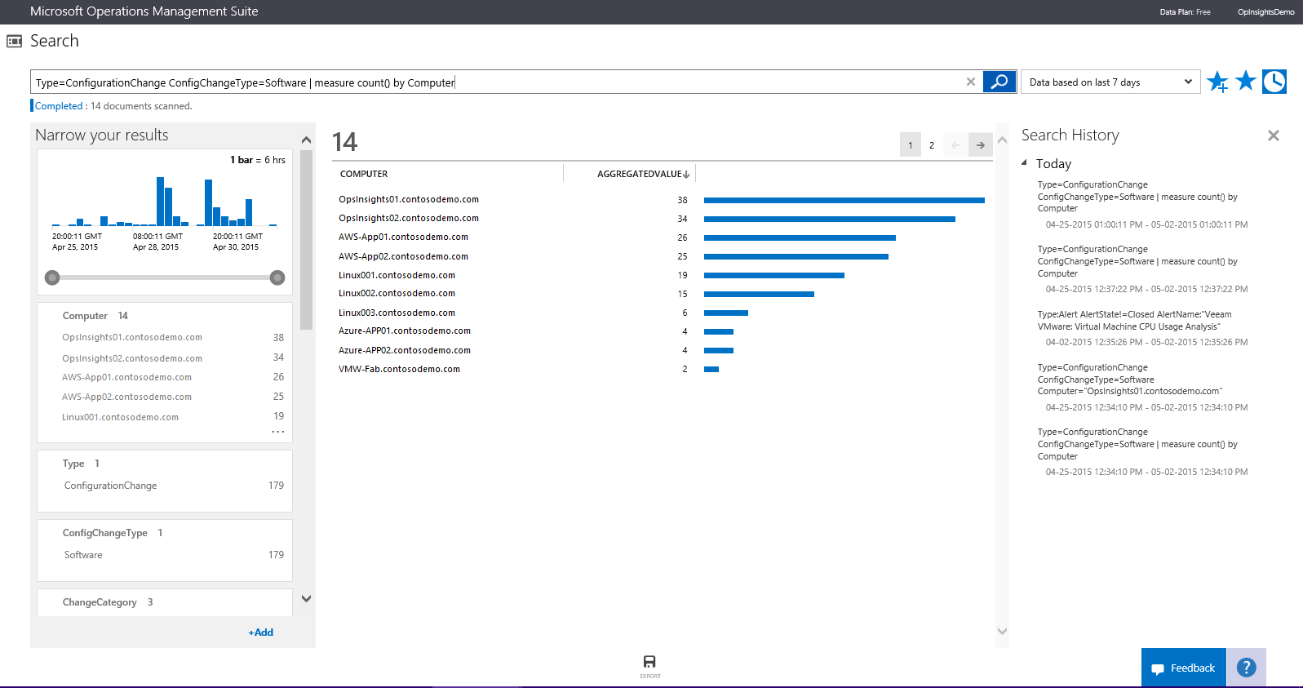
Integrated Search
Combine and correlate any machine data from multiple sources
Query, and filter the results by using facet controls.
Automated data visualization
Metrics pivoted around a particular problem areas
Common search queries

Slide 44
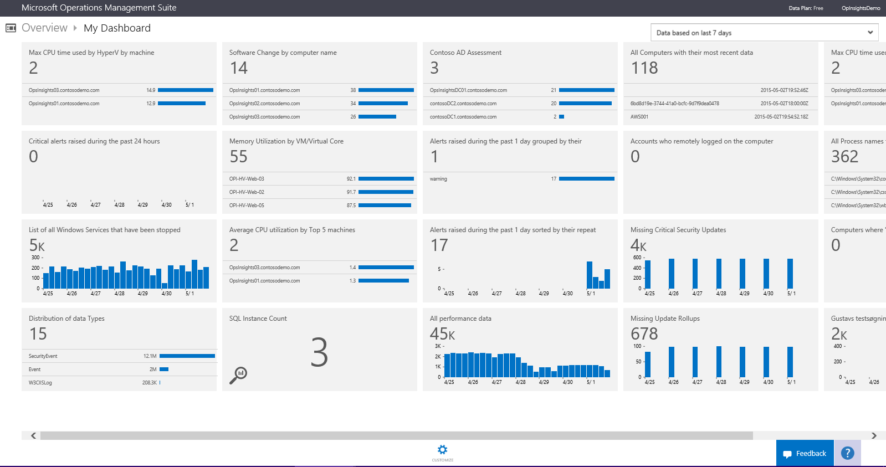
Custom Dashboard
Visualize all of your saved searches, providing a single lens to all your environment
Custom or sample searches
Customizable visual information
Shareable across teams

Slide 45

Insight to drive action
Analyze, search, and correlate data across a hybrid environment
Simple and unified experience
Gain immediate insight
Rapidly troubleshoot and auto remediate
Log collection and analytics App and server dependency mapping Network health monitoring

Slide 46
Ways to Send Data to Log Analytics
System Center Operations Manager
Management Groups for Entire Deployment
Clients Attached Directly (agent-based)
Windows 64-bit agent
Azure Linux VMs agent
Azure Storage Account
OMS Gateway

Slide 47






UNIFIED EXPERIENCE
COLLECT AND INDEX DATA
SEARCH AND INVESTIGATE
CORRELATE AND ANALYZE
VISUALIZE AND REPORT
MONITOR AND ALERT
Windows agents
Log Analytics
Automation
Site Recovery
Backup
SCOM
Linux / FluentD
Management and Monitoring
REST Collection API
Sample list of log/metrics that log analytics collects:
Custom Application/Infra logs
Windows event logs
Window performance counters
Security Event Logs
IIS Logs
ETW logs
Azure Diagnostics
SaaS services
O365
Azure Storage /
Azure Diagnostics
Event Hub
Log Stash

Slide 48
Automation and Control

Slide 49
Reduce errors and boost efficiency
Reduction of time-consuming, error-prone cloud management tasks
Quick start of automation tasks using Runbook Gallery
Better visibility into automation activities
Creation, monitoring, management, and deployment of resources in hybrid environments
Ready-to-use automation sample, utility, and scenario runbooks
Runbook monitoring with easy-to-read dashboard charts and log records

Slide 50
Automation Scenarios
Patch, Update & Backups
Patch Azure VMs without downtime
Automatic regeneration of storage account keys
Backup IaaS VMs on a schedule or based on policy
Change Control & Provisioning
Integrate with 3rd Party Change Control Systems
Deploy Application from GIT, Run Validation Tests and Swap for Production if Test Pass
Monitoring & Remediation
Automatically add new capacity based on policies
Notify Users of under utilized Subscriptions & shutdown VMS

Slide 51
Insight to drive action
Automate processes and manage configuration to increase speed
Continuous services
Hybrid automation
Consistent enterprise
Process automation Change configuration management Patch management

Slide 52

Security and Compliance

Slide 53
Insight to drive action
Vision for hybrid cloud workload protection
+
Azure Security Center
Security + Compliance
Security built-in to Azure
Asset discovery and ongoing security assessment
(anti-malware, system updates, encryption, virtual network configurations)
Actionable security recommendations
Security policy for IT governance
Integrated management and monitoring of partner security solutions
Threat detection using advanced analytics
Advanced threat intelligence across platforms
Collection of security data from virtually any source (Azure or AWS, Windows Server or Linux, VMware or OpenStack)
Insight into security status (anti-malware, system updates)
Correlations to detect malicious activities and search for rapid investigation
Integrates operational and security management
Threat detection using advanced analytics

Slide 54

Protection and Recovery

Slide 55
Cloud Backup Safeguard your valuable data
Decrease reliance on tape backup to save money and increase agility
Azure Backup integrated with SCDPM protects enterprise workloads including SharePoint, Exchange, SQL Server, and Hyper-V VMs,
Lowers the management costs of backing up remote/branch offices
Reduce the dependence on offsite tape backup to accelerate recovery time

Slide 56
Recovery Protect your applications
Azure
Orchestrate the recovery of your apps for simplified disaster recovery
Improve Recovery-Time-Objectives (RTO) and Recovery-Point-Objectives (RPO) for both planned and unplanned outages
Achieve zero impact disaster recovery drills
Minimize app errors and data loss with application consistent recovery points
Replication for heterogeneous environments: Hyper-V, VMware, and physical

Slide 57
Insight to drive action
Azure backup and site recovery
Reduced cost with no hardware
Reduced complexity and simpler execution
Increased compliance and availability
Advanced data protection Application and site recover Storage archival and management

